Slide 1

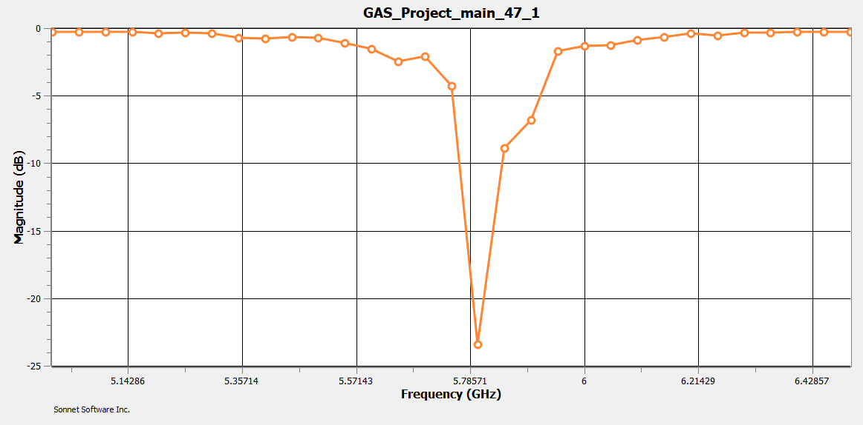
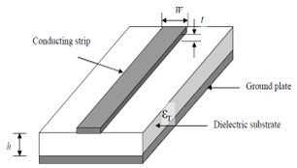
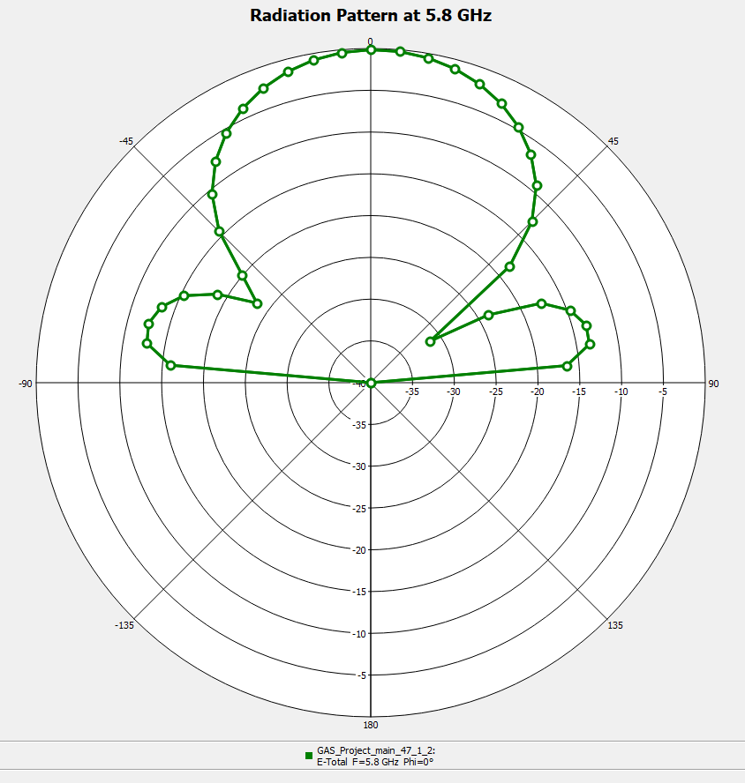
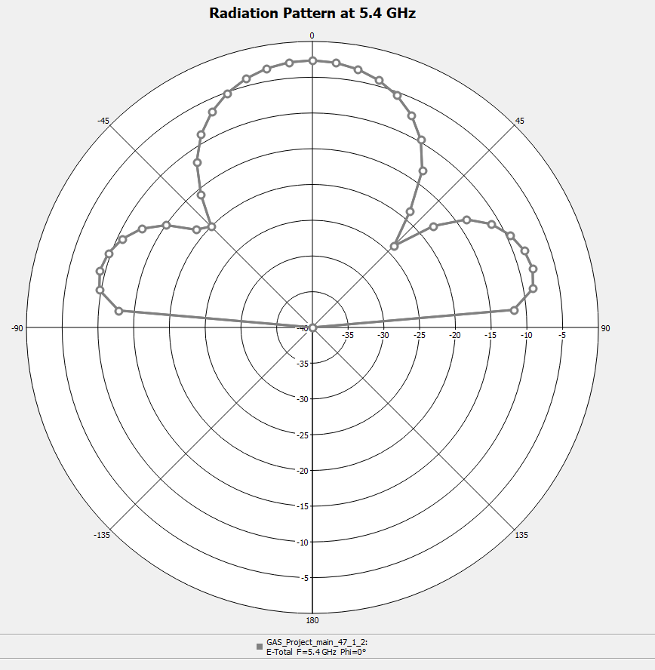
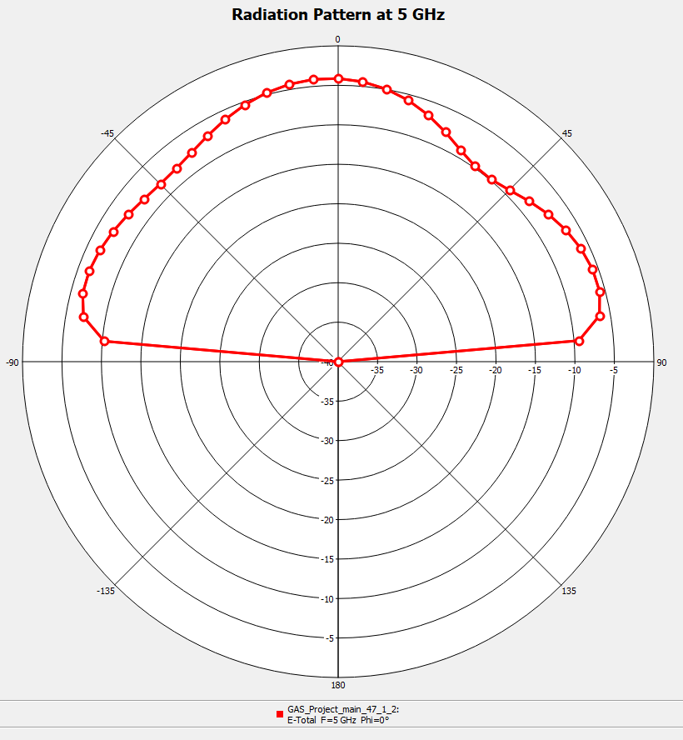
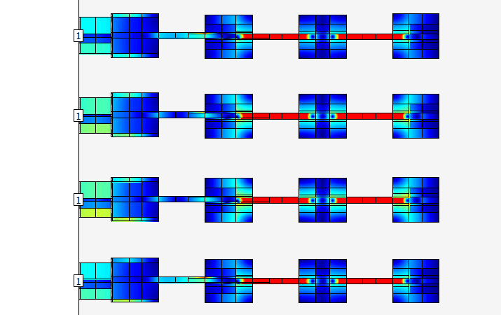
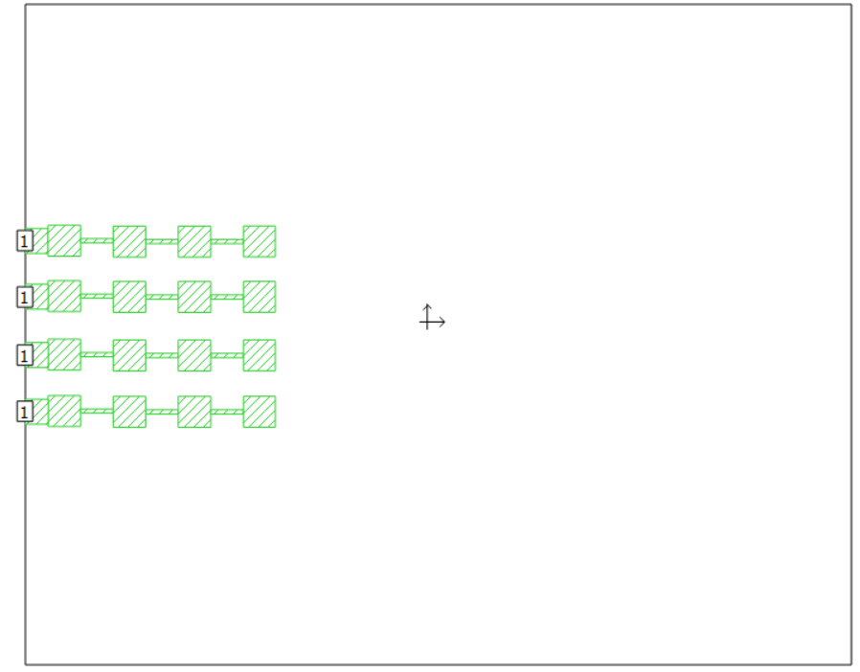
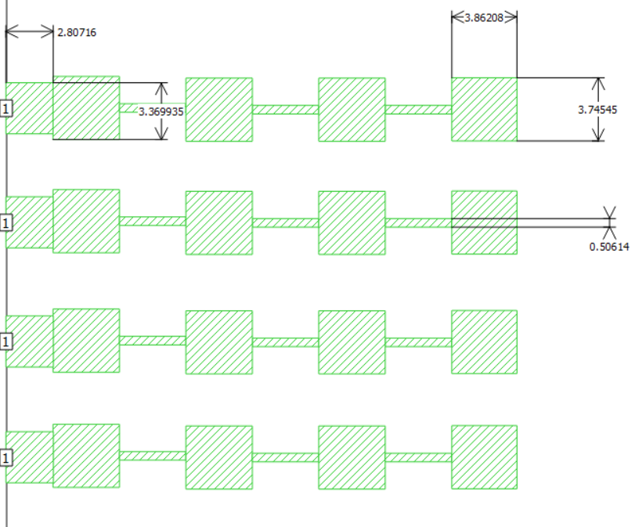
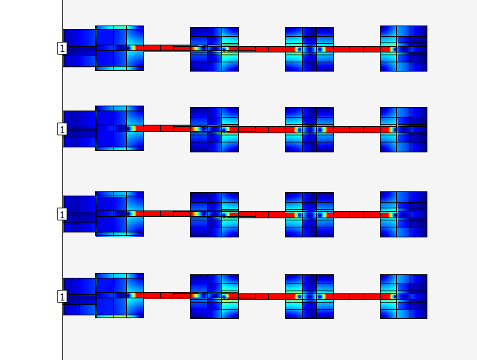
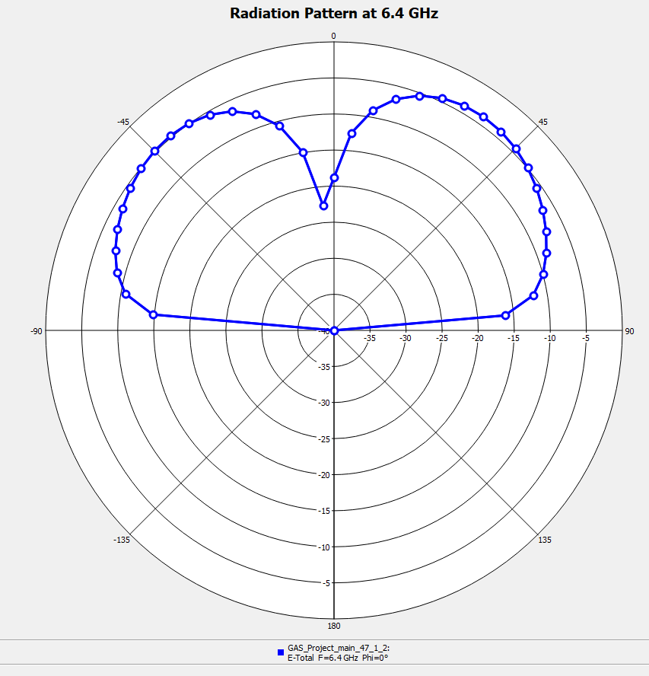
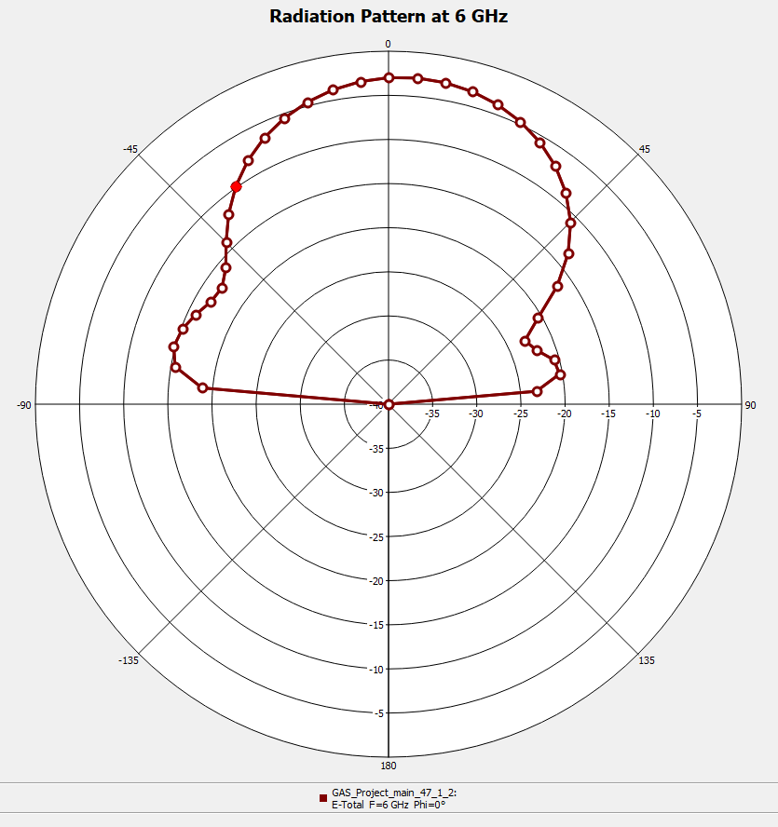
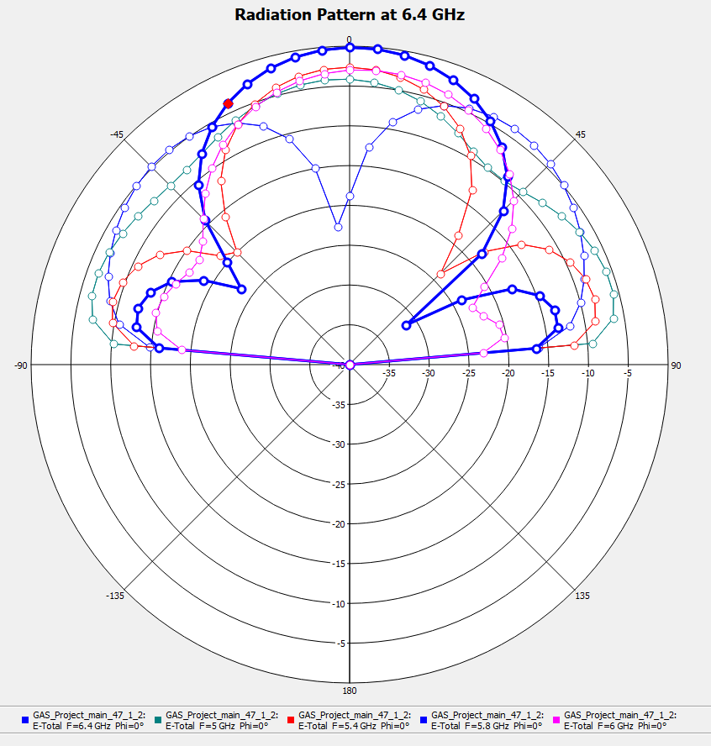
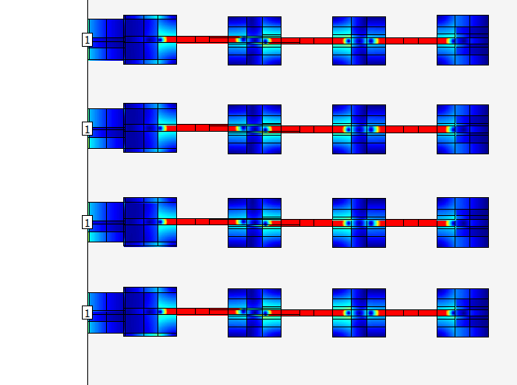

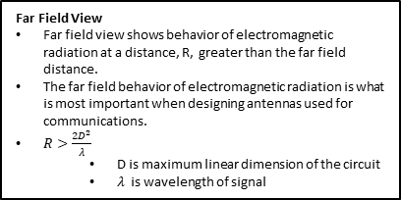
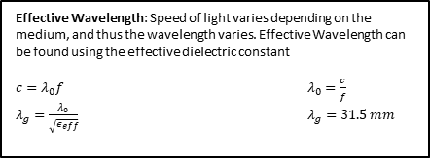
Implementation of Series Fed Patch Antenna for Beam Focusing by: William Logan Spooner, Dr. Shantanu Chakraborty
Introduction:
One of the major Industrial, Scientific and Medical (ISM) frequency band covers from 5.725 GHz to 5.875 GHz. This 5.8 GHz provides additional bandwidth for ISM communication. However, being at higher frequency it is more limited in terms of range than 2.4 GHz. This proposed antenna employs the beam formation technique to overcome this limitation. Using a series of microstrip patch arrays we can improve the directionality of the radiation beam pattern and achieve a higher directional gain.
Effective Dielectric Constant: Determines ability of a substance to store energy as electric field. Must use dielectric constant of PCB material (≈4.4) and dielectric constant of air (1) to determine the average, or effective, dielectric constant.
Effective Wavelength: Speed of light varies depending on the medium, and thus the wavelength varies. Effective Wavelength can be found using the effective dielectric constant
$c=λ_{0}f$ $λ_{0}=\frac{c}{f}$
$λ_{g}=\frac{λ_{0}}{\sqrt{ε_{eff}}}$ $λ_{g}=31.5 mm$
Far Field View
Far field view shows behavior of electromagnetic radiation at a distance, R, greater than the far field distance.
The far field behavior of electromagnetic radiation is what is most important when designing antennas used for communications.
$R>\frac{2D^{2}}{λ}$
D is maximum linear dimension of the circuit
$λ$ is wavelength of signal
Simulated S11 results: Using Sonnet’s graphing software, we were able to design the patch to have a 28.29 dB loss at 4.998 GHz. This is roughly a 99.85% loss making this a very effective antenna at the target wavelength.
$$ε_{eff}=\frac{ε_{r}+1}{2}+\frac{ε_{r}−1}{2}{\left(1+\frac{10h}{w}\right)}^{−\frac{1}{2}}+0.468\frac{ε_{r}+0.5}{1.5}\sqrt{\frac{t}{w}}$$
w=4.55mm
t=0.03mm
h=1.6mm
$$ε_{r}≈4.4$$
$$ε_{eff}≈3.6$$
Box Resonance: An issue we had in designing the patch antenna was box resonance causing unwanted power drops at other frequencies. This box resonance comes from the software assuming the patch design is inside of a metal box, so there can be a resonance with the patch and the box walls. We combatted this by increasing the box size to significantly reduce the resonance.
Simulated Far Field: The goal of our project was to design an antenna that effectively radiated forward to reduce loss of signal in other directions.
Current Diagrams: 5.4 GHz, 5.8 GHz, and 6GHz
Design: Once we had an effective wavelength to target, we could design the antenna using Sonnet Lite. We started by sizing the patches such that total length of the patches and lines in each row were the length of the target wave. We then made small adjustments to the size until we got an efficient power loss (S11) at close to 5.8 GHz.
Design with full box size. Our final design utilized a box of 80x100mm. This size successfully reduced the incidence of box resonance while keeping the design small.

